Slide 1
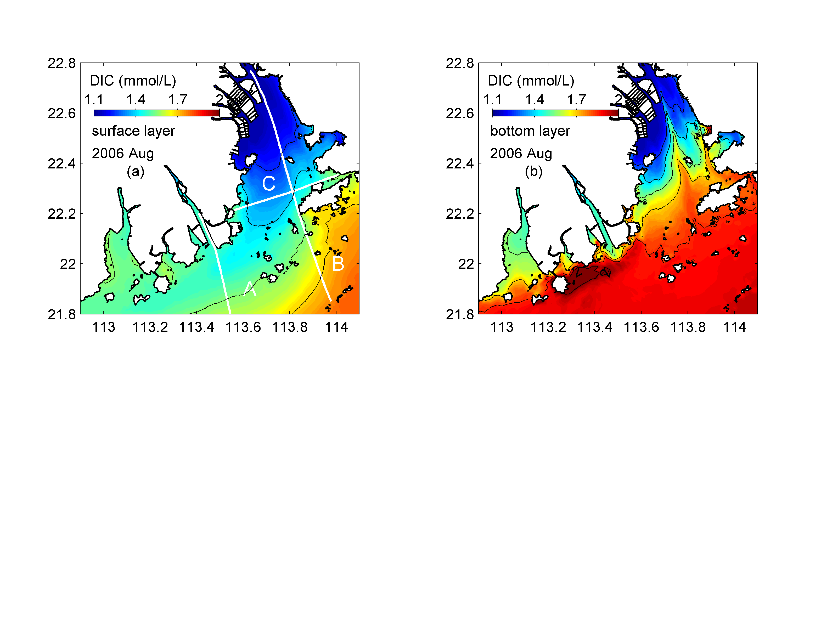
Notes:
Figure 6. Horizontal distribution of DIC in August 2006 summer; the left panels show the simulation results for the surface layer, while the right panels show the results for the bottom layers.

Slide 2
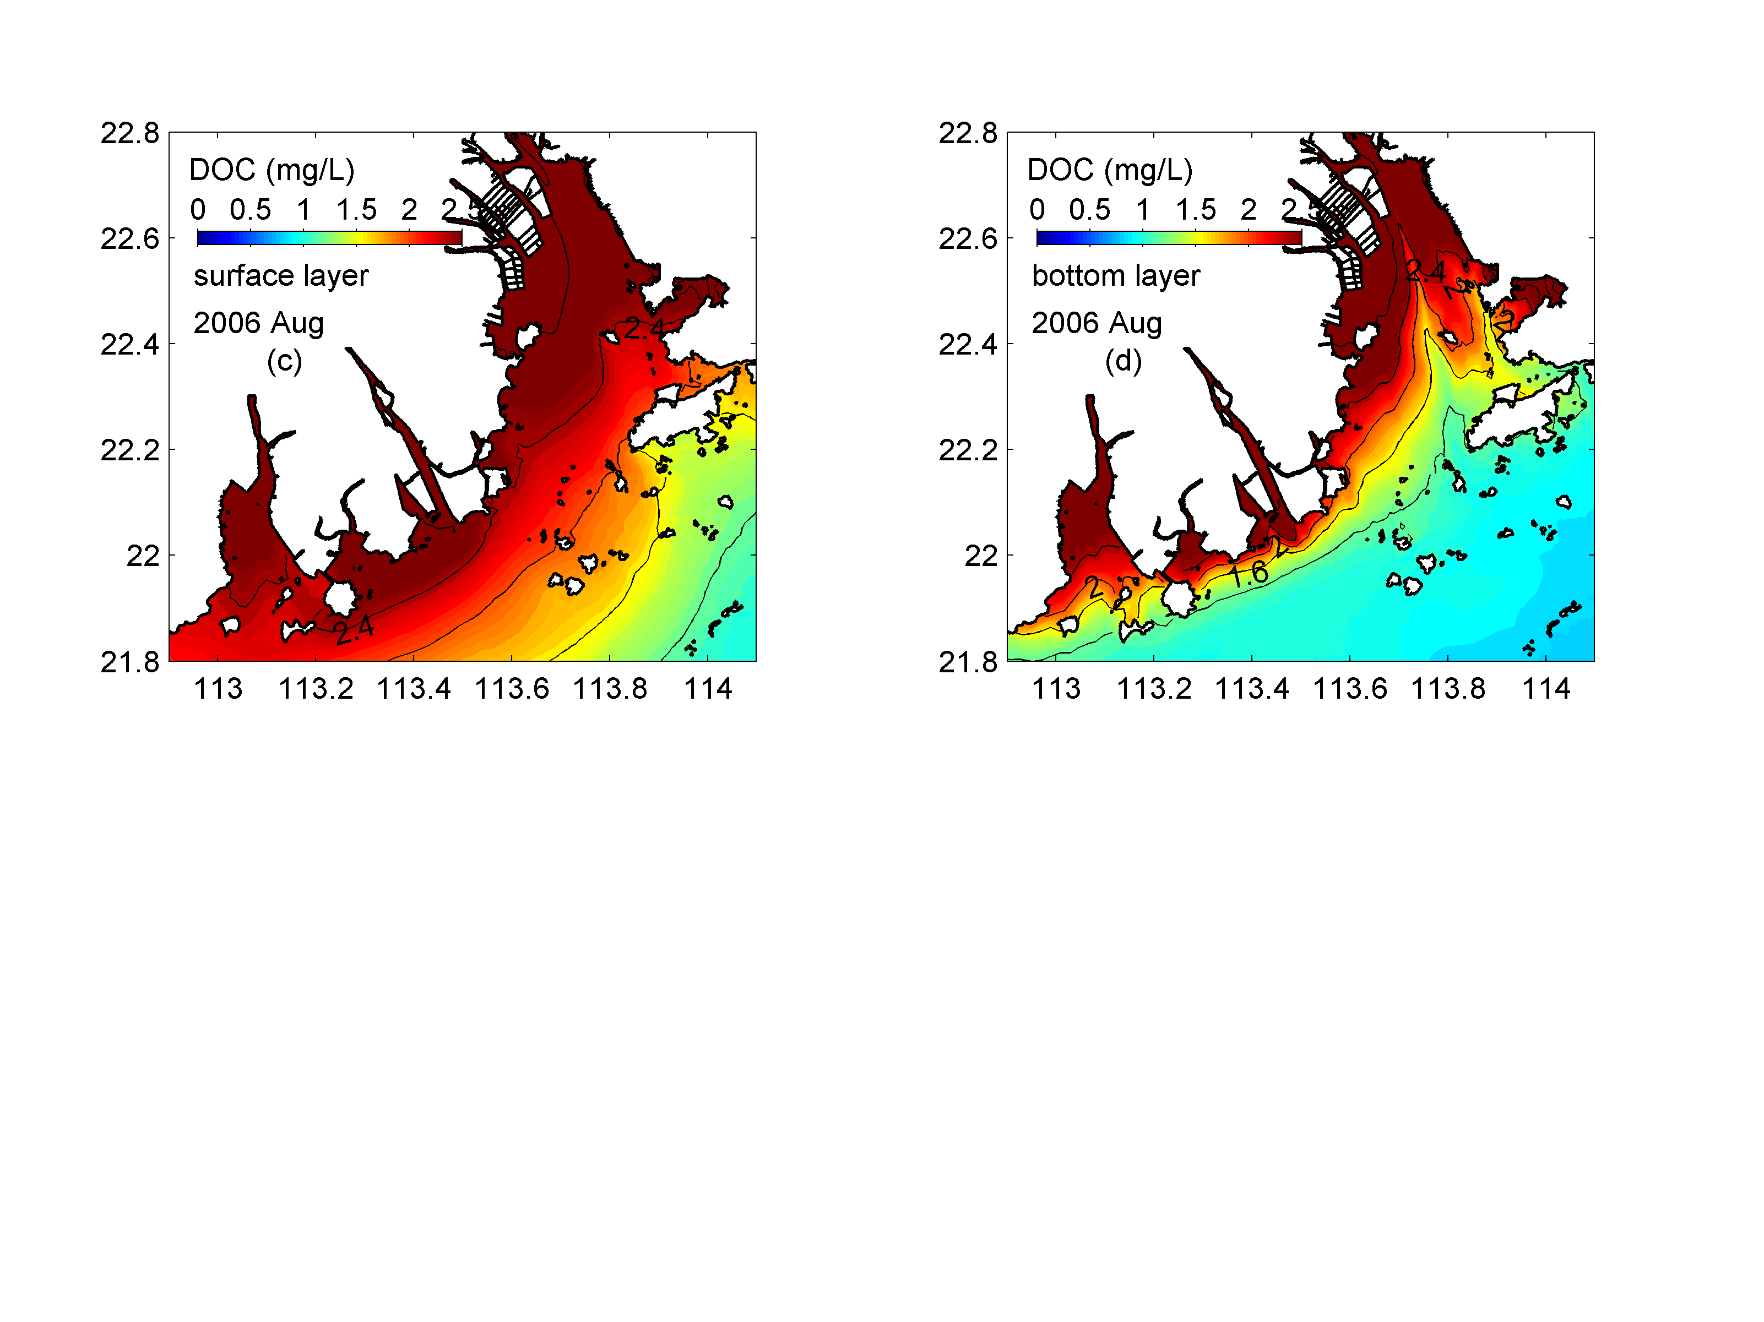
Notes:
Figure 6. Horizontal distribution of DOC in August 2006 summer; the left panels show the simulation results for the surface layer, while the right panels show the results for the bottom layers.

Slide 3
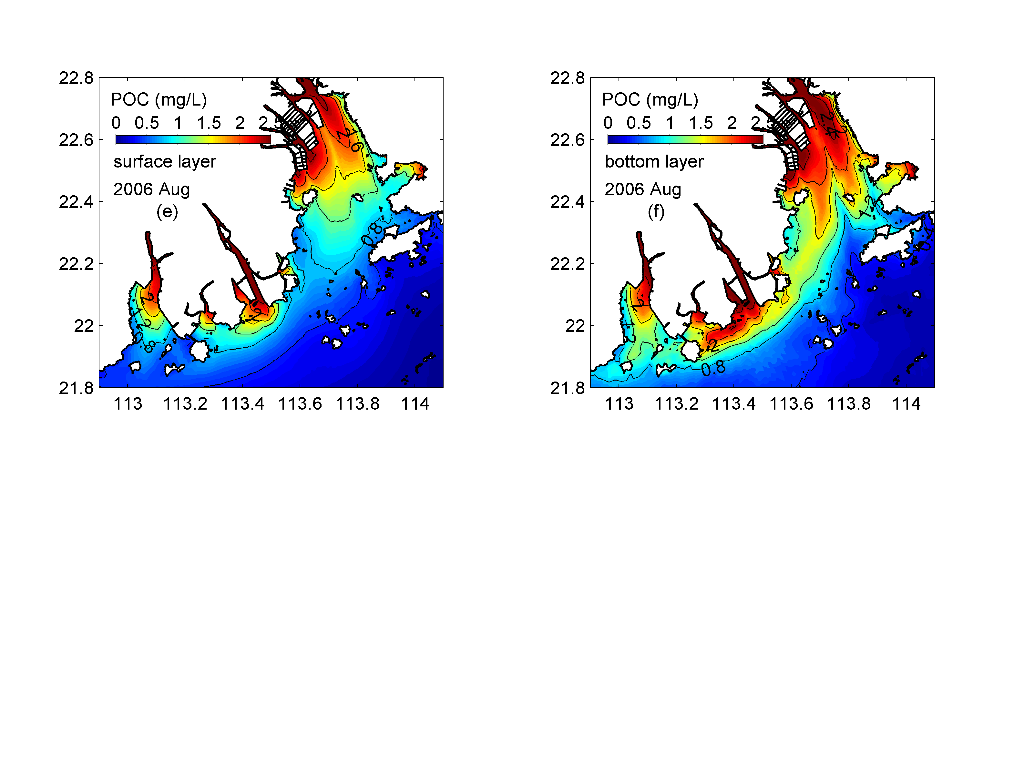
Notes:
Figure 6. Horizontal distribution of POC in August 2006 summer; the left panels show the simulation results for the surface layer, while the right panels show the results for the bottom layers.

Slide 4
Notes:
Figure 6. Horizontal distribution of DIC (upper panels), DOC (middle panels) and POC (lower panels) in August 2006 summer; the left panels show the simulation results for the surface layer, while the right panels show the results for the bottom layers.

